Slide 1

DEPARTMENT OF ARTIFICAL INTELLIGENCE AND DATA SCIENCE
Project Review
“A Hybrid Neural Network for EEG-based Depression Screening Using CNN+LSTM”
Project Team Members
Name USN
B.LATHA SREE 1SJ22AD006
C S MOUNIKA 1SJ22AD008
M.CHARAN 1SJ22AD024
Project Guide
Badrinath K
Assistant Professor

Slide 2

A Hybrid Neural Network for EEG-based Depression Screening Using CNN
TABLE OF CONTENTS
  Abstract
  Purpose
  Scope
  Problem Statement
  Introduction
  Objectives
  Literature Survey
  Existing system
  Proposed system
  System Requirement and Specifications
Design and Architecture
Modules split-up
Implementation
Testing
Screen shots of output
Conclusion
Future Enhancement
References

Slide 3
A Hybrid Neural Network for EEG-based Depression Screening Using CNN
ABSTRACT
Depression is a widespread psychological disorder affecting people of all ages. Early diagnosis is crucial, and EEG signals can help assess mental health. This project proposes a fully automated Depression Detection System using a novel Hybrid Neural Network, DepHNN, which combines CNN for temporal learning and LSTM for sequence learning. EEG data from 34 depressed and 30 normal drug-free individuals were used. The system achieves 98.27 accuracy and a MAE of 0.0237, offering an efficient, accurate, and low-complexity solution for EEG-based depression screening.

Slide 4
A Hybrid Neural Network for EEG-based Depression Screening Using CNN
PROBLEM STATEMENT
Depression is a major mental health issue affecting over 322 million people worldwide, contributing to significant emotional, social, and economic burdens. Traditional methods for diagnosing depression, such as clinical interviews and self-reported questionnaires, are subjective and time-consuming. EEG-based diagnosis provides objective insights into brain activity but is prone to human error due to the complexity of interpreting EEG signals. Thus, there is a critical need for an automated and accurate depression screening system using EEG signals.

Slide 5
A Hybrid Neural Network for EEG-based Depression Screening Using CNN
PURPOSE
A fully automated, intelligent screening system is proposed for detecting depression using electroencephalogram (EEG) signals. By leveraging a hybrid deep learning architecture that combines Convolutional Neural Networks (CNN) and Long Short-Term Memory (LSTM) networks, the system enhances diagnostic accuracy while minimizing human intervention and computational overhead.

Slide 6
A Hybrid Neural Network for EEG-based Depression Screening Using CNN
SCOPE
An advanced diagnostic framework is developed to enable automated identification of depressive disorders using EEG signals. The solution encompasses the complete workflow, including EEG signal acquisition, preprocessing, feature extraction, model training, and performance evaluation. It is further integrated into a deployable architecture suitable for clinical environments and mental health screening platforms, ensuring reliability, scalability, and practical applicability.

Slide 7
A Hybrid Neural Network for EEG-based Depression Screening Using CNN
INTRODUCTION
Depression affects over 322 million people worldwide, with a higher incidence among females. Although it is a treatable condition, nearly half of the cases remain undiagnosed due to factors like limited awareness, insufficient resources, and incorrect diagnoses. EEG signals, being non-invasive and cost-effective, serve as valuable biomarkers for identifying neurological disorders, including depression. However, their complexity makes manual analysis challenging. To address this, the project proposes a hybrid LSTM-CNN model (DepHNN) for efficient and accurate detection of depression using EEG data.

Slide 8
A Hybrid Neural Network for EEG-based Depression Screening Using CNN
OBJECTIVES
Develop a CNN-LSTM model for automated depression detection using EEG signals.
Improve adaptability using cross-validation and diverse datasets.
Apply regularization techniques such as L2 regularization and adaptive learning rate optimization.
Enhance model accuracy and generalization using dropout, data augmentation, and early stopping.
Minimize computational complexity and latency to enable real-time depression screening on portable and cloud-based platforms.

Slide 9
A Hybrid Neural Network for EEG-based Depression Screening Using CNN
LITERATURE SURVEY
Author(s) | Research Paper Title | Advantages | Disadvantages | Implementation in Project
A. Seal | DeprNet: A Deep Convolution Neural Network Framework for Detecting Depression Using EEG | High accuracy with CNNs; Effective feature extraction | High model complexity; requires large training data | CNN-based feature extraction in DepHNN
Z. Wan | HybridEEGNet: A Convolutional Neural Network for EEG Feature Learning and Depression Discrimination | CNN efficiently learns complex EEG features; Good generalization | Needs optimization for small datasets | Supports the hybrid model concept (CNN + sequence learning)
S. Sun | EEG-Based Depression Recognition by Combining Functional Brain Network and Traditional Biomarkers | Enhances detection with connectivity features | Moderate performance; complex preprocessing needed | Highlights combination of local and global feature learning
A. Sekhar | Performance Evaluation of LSTM Models in Detection of Depression from EEG Signals | LSTM captures sequential dependencies effectively | Needs careful tuning; high computational load | Justifies the use of LSTM layers in DepHNN

Slide 10
A Hybrid Neural Network for EEG-based Depression Screening Using CNN
EXISTING SYSTEM
Earlier systems used machine learning models like SVM, PNN, and Random Forest with manually extracted EEG features. This process was slow, required expert knowledge, and gave only moderate robustness, even though some models reached 98% accuracy. These systems often missed deeper brain patterns and did not generalize well. Deep learning improved performance by automating feature extraction. CNN models achieved around 93.5% accuracy, while CNN-LSTM models reached 97.66%. The DepHNN model combines CNN and LSTM and, using ReLU, softmax, windowing, and the Adam optimizer, achieves 99.1% accuracy with low computational complexity.

Slide 11
A Hybrid Neural Network for EEG-based Depression Screening Using CNN
PROPOSED SYSTEM
DepHNN is a hybrid deep learning model designed to classify EEG signals into depressed and non-depressed states. It processes raw EEG data directly, removing the need for manual feature extraction. A CNN layer learns spatial patterns across EEG channels, and two LSTM layers capture time-based changes in brain activity. Dropout is applied to reduce overfitting, while dense layers refine the learned features. A softmax layer finally classifies the signals into two categories. This approach offers an accurate, automated, and efficient solution for EEG-based depression detection.

Slide 12
A Hybrid Neural Network for EEG-based Depression Screening Using CNN
SYSTEM REQUIREMENT AND SPECIFICATIONS
SI.NO | Software Requirements | Hardware Requirements
1 | Operating System : Windows11 | System : Intel i5
2 | Coding Language : Python 3.10 | GPU : Minimum NVIDIA 4 GB VRAM
3 | Frontend Language : HTML5, CSS3, JavaScript (ES6+) | Server : 2-core CPU, 2-4 GB RAM
4 | Backend Language : Django, SQLite | Input Devices : Any modern computer with a web browser .
5 | Tools : Keras, TensorFlow ,SciPy, MNE-Python | Ram : 8 GB
6 | Visualization : Chart.js, Matplotlib , Seaborn

Slide 13
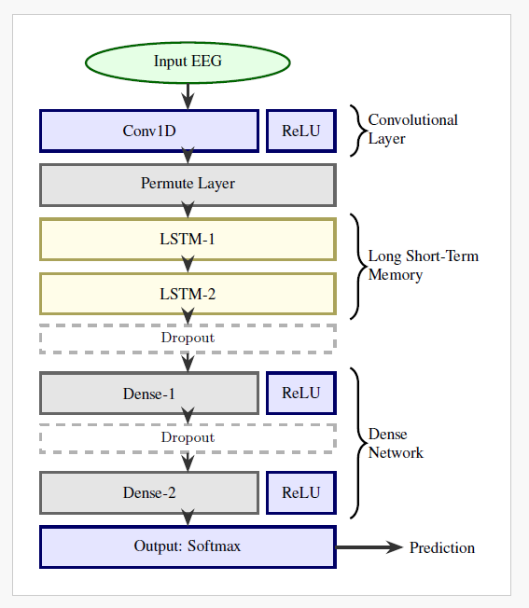
A Hybrid Neural Network for EEG-based Depression Screening Using CNN
DESIGN AND ARCHITECTURE
MODEL ARCHITECTURE

Slide 14
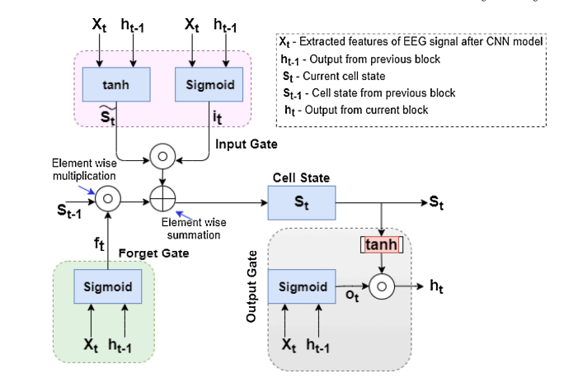
A Hybrid Neural Network for EEG-based Depression Screening Using CNN
LSTM ARCHITECTURE

Slide 15
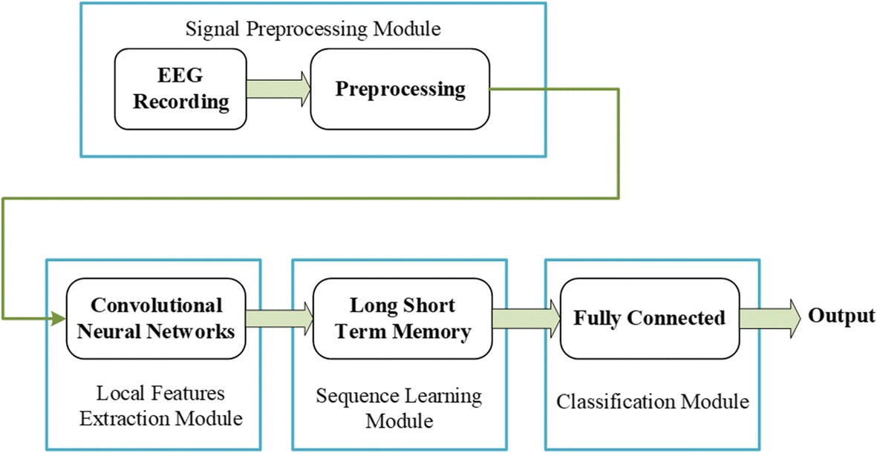
A Hybrid Neural Network for EEG-based Depression Screening Using CNN
FLOW CHART

Slide 16
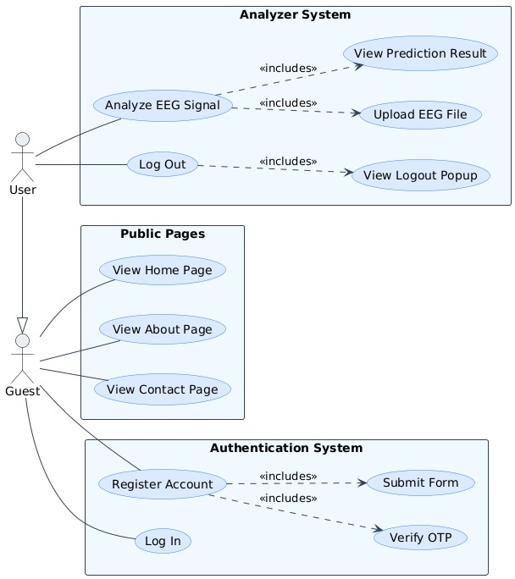
A Hybrid Neural Network for EEG-based Depression Screening Using CNN
USE CASE DIAGRAM:

Slide 17
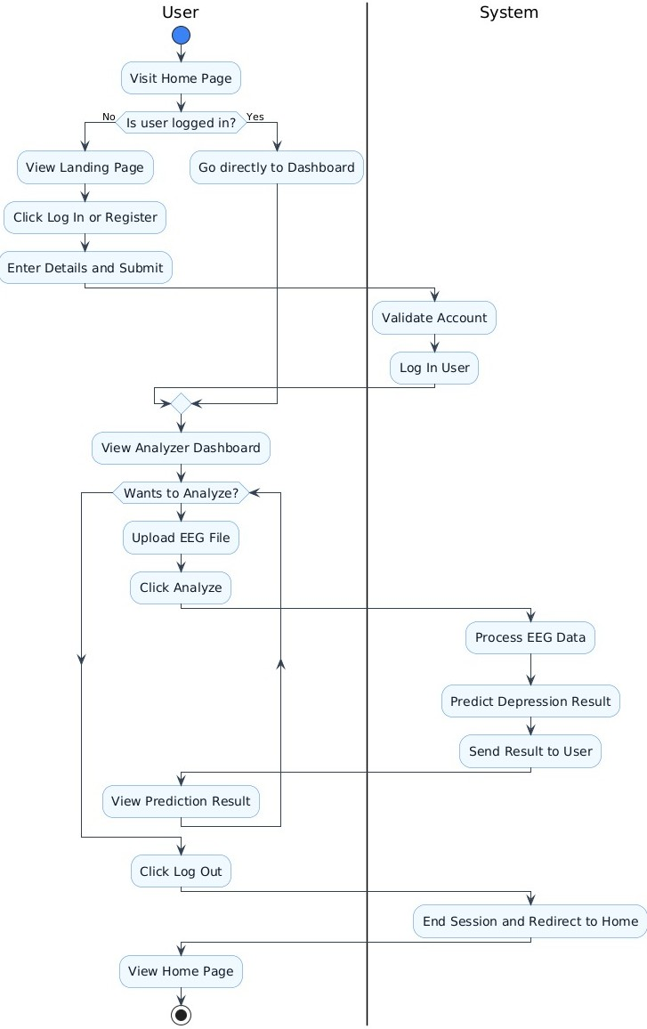
A Hybrid Neural Network for EEG-based Depression Screening Using CNN
ACTIVITY DIAGRAM

Slide 18
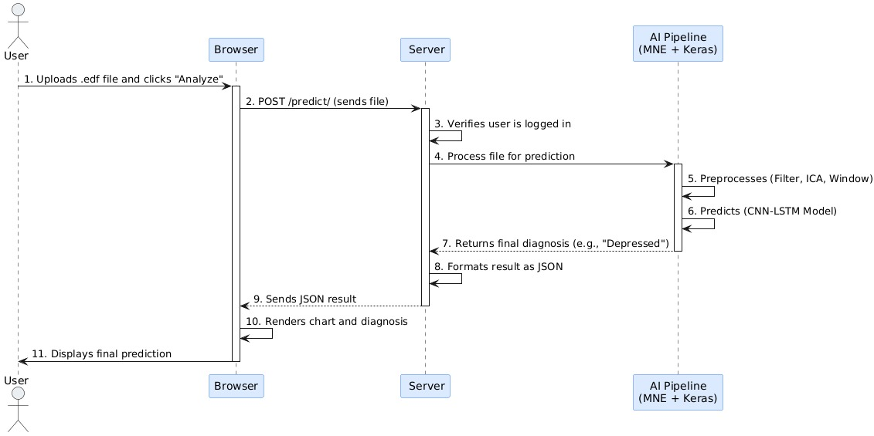
A Hybrid Neural Network for EEG-based Depression Screening Using CNN
SEQUENCE DIAGRAM

Slide 19
A Hybrid Neural Network for EEG-based Depression Screening Using CNN
MODULES SPLIT-UP
LIST OF MODULES
CNN (Convolutional Neural Network)
LSTM (Long Short-Term Memory)
ReLU (Rectified Linear Unit)
Softmax

Slide 20

A Hybrid Neural Network for EEG-based Depression Screening Using CNN
Module 1: CNN(Convolutional Neural Network)
CNN is a is a deep learning model mainly used for feature extraction from data such as images or EEG signals.
It captures spatial and temporal patterns automatically using convolution and pooling operations.
Purpose in the Model:
Extracts key spatial features from EEG data.
Captures local signal patterns automatically.
Reduces manual feature extraction.
Provides feature maps for LSTM processing.

Slide 21
.
A Hybrid Neural Network for EEG-based Depression Screening Using CNN
Module 2:LSTM (Long Short-Term Memory)
LSTM is a type of Recurrent Neural Network (RNN) designed to model time-series or sequential data by remembering long-term patterns.
It uses internal memory (called cells) and gates to regulate the flow of information.
Purpose in the Model:
Remembers important patterns over multiple time steps.
Helps understand temporal dependencies in EEG signals.
Improves performance on sequence data like brainwave activity.
Avoids vanishing gradient problems found in traditional RNNs.

Slide 22
A Hybrid Neural Network for EEG-based Depression Screening Using CNN
Module 3: Softmax
Softmax is an activation function used in the output layer of a neural network for classification tasks. It converts raw scores (logits) into probabilities, so that the sum of all output values equals 1.
Purpose in the Model:
Converts the model’s raw output into interpretable probabilities.
Helps the model make a clear decision about which class (e.g., depressed / not depressed) the input belongs to.
Ensures the output is a probability distribution.
Module 4:ReLU (Rectified Linear Unit)
ReLU is an activation function used in neural networks.
Purpose in the Model:
Adds non-linearity to the model.
Allows the neural network to learn complex features.
Speeds up convergence compared to sigmoid/tanh.

Slide 23
A Hybrid Neural Network for EEG-based Depression Screening Using CNN
IMPLEMENTATION
CNN ALGORITHM:
Input Layer: Receives EEG windows of shape (19 × 256).
Conv1D Layer:
  Filters: 64 filters with a kernel size of 5.
  Sliding Window: Each filter slides along the time dimension, simultaneously examining all 19 channels.
  Spatial Feature Learning: Filters capture diverse spatial patterns, including low/high-frequency waves, eye-blink artifacts, and frontal alpha asymmetry.
Activation (ReLU): Rectified Linear Unit sets negative values to zero, preserving key activations and reducing noise.
Output Feature Map: Produces a high-level spatial representation, e.g., (64 filters × 252 time steps), which is then passed to LSTM layers for temporal modeling.

Slide 24
A Hybrid Neural Network for EEG-based Depression Screening Using CNN
CNN IMPLEMENTATION SNIPPET:
from tensorflow.keras.models import Sequential
from tensorflow.keras.layers import Conv1D, ReLU
model = Sequential()
# Input: (256 time steps, 19 channels)
model.add(Conv1D(filters=64, kernel_size=5, input_shape=(256, 19)))
model.add(ReLU())
# Output: feature map of shape (252, 64)

Slide 25
A Hybrid Neural Network for EEG-based Depression Screening Using CNN
2. LSTM ALOGRITHM:
Input Layer: Receives CNN feature map as a sequence over time.
Stacked LSTM Layers:
  First Layer: 64 units capturing short- and mid-term temporal dependencies.
  Second Layer: 32 units for higher-level temporal abstraction.
Gating Mechanisms: Input, forget, and output gates control memory updates and flow of information.
Output: Final hidden state encodes temporal EEG patterns, passed to dense layers for classification.

Slide 26
A Hybrid Neural Network for EEG-based Depression Screening Using CNN
LSTM IMPLEMENTATION SNIPPET:
from tensorflow.keras.models import Sequential
from tensorflow.keras.layers import LSTM, Dense
model = Sequential()
model.add(LSTM(64, return_sequences=True, input_shape=(252,64)))
model.add(LSTM(32))
model.add(Dense(16, activation='relu'))
model.add(Dense(2, activation='softmax')) # Depressed / Healthy

Slide 27
A Hybrid Neural Network for EEG-based Depression Screening Using CNN
TESTING
1. UNIT TESTING:
Test Case | Test Name | Test Description | Input | Expected Output | Actual Output | Test Result
UTC01 | User Model Functionality | To verify creation, validation, and password hashing of the CustomUser model. | Valid and invalid user data (missing username, weak password, etc.) | User is created successfully with valid data, errors are raised for missing fields, and password is hashed correctly. | Model loads successfully and returns valid prediction output. | Success
UTC02 | OTP Generation | To test OTP generation, database storage, and expiry mechanism. | OTP request for a registered user | A 6-digit OTP is generated, stored, and correct | OTP generated correctly, stored in model | Success

Slide 28
A Hybrid Neural Network for EEG-based Depression Screening Using CNN
UTC03 | Form Validation (Registration & Login) | To validate input data for RegistrationForm and LoginForm. | Valid/invalid email, password, and username combinations | Forms accept valid inputs, reject invalid/duplicate entries. | Validation and error handling performed as expected. | Success
UTC04 | EEG Data Preprocessing | To verify preprocessing steps using MNE-Python functions. | EEG .edf files (valid and invalid) | Data loaded, filtered (0.5–45 Hz), resampled to 256 Hz, ICA applied, normalized, and windowed correctly. | Each preprocessing function executed correctly, invalid files handled gracefully. | Success
UTC05 | Keras Model Loading and Prediction | To ensure model loads and performs prediction with correct input shape. | Dummy EEG input of shape (1, 19, 256) | Model loads successfully and returns valid prediction output. | Model loaded without error and predicted correctly. | Success

Slide 29
A Hybrid Neural Network for EEG-based Depression Screening Using CNN
2. INTEGRATED TESTING:
Test Case | ITC01
Test Name | Module Interaction and Data Flow Validation
Test Description | To verify that integrated modules function correctly and data flows seamlessly between system components.
Input | User registration, login, EEG file upload, and prediction requests.
Expected Output | Successful user creation and authentication, proper preprocessing of EEG data, and accurate model prediction with a JSON response.
Actual Output | All modules interacted correctly-registration, login, preprocessing, and prediction executed smoothly with consistent data flow.
Test Result | Success

Slide 30
A Hybrid Neural Network for EEG-based Depression Screening Using CNN
3. SYSTEM TESTING:
Test Case | STC01
Test Name | End-to-End System Functionality Validation
Test Description | To verify that the fully integrated DepHNN Analyzer performs all operations correctly under real-world conditions, including data upload, analysis, and prediction.
Input | EEG .edf files (both healthy and depressed datasets) uploaded by registered users.
Expected Output | The system should successfully complete the full workflow — registration, login, file upload, analysis, result display, and logout — with accurate depression predictions and stable performance.
Actual Output | The complete workflow was executed successfully with consistent and accurate predictions; system remained stable under load.
Test Result | Success

Slide 31
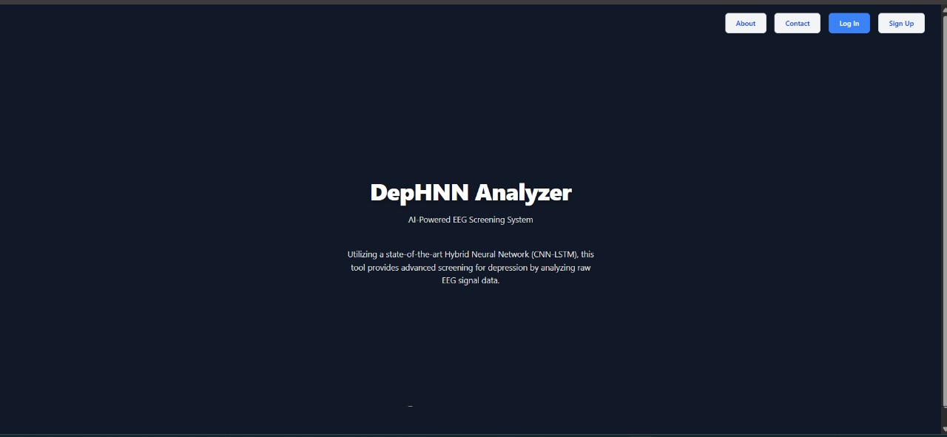
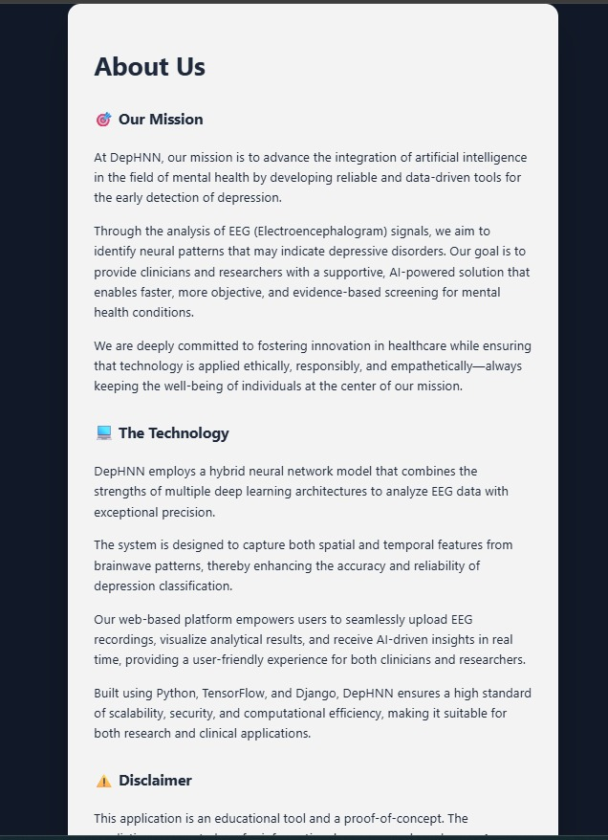
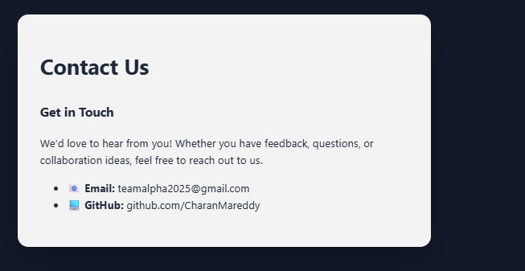
A Hybrid Neural Network for EEG-based Depression Screening Using CNN
SCREEN SHOTS OF OUTPUT

Slide 32
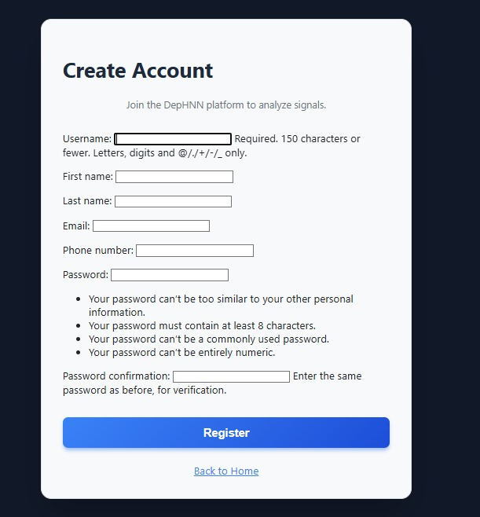
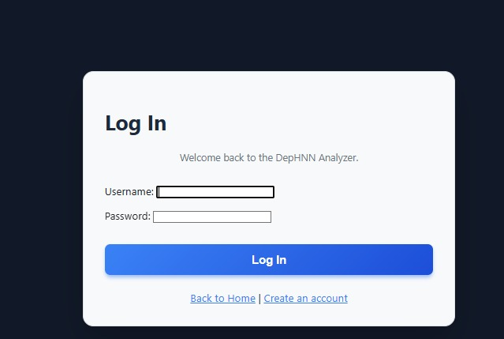
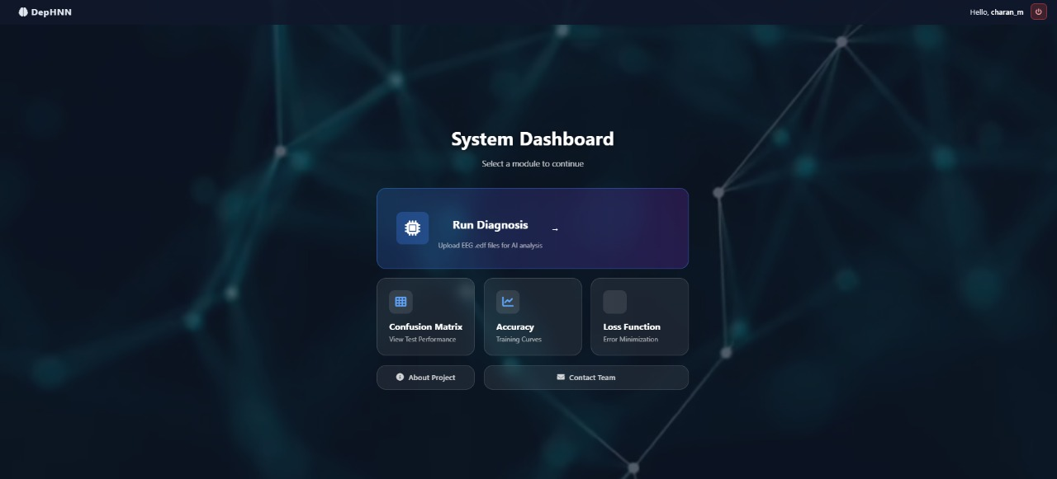
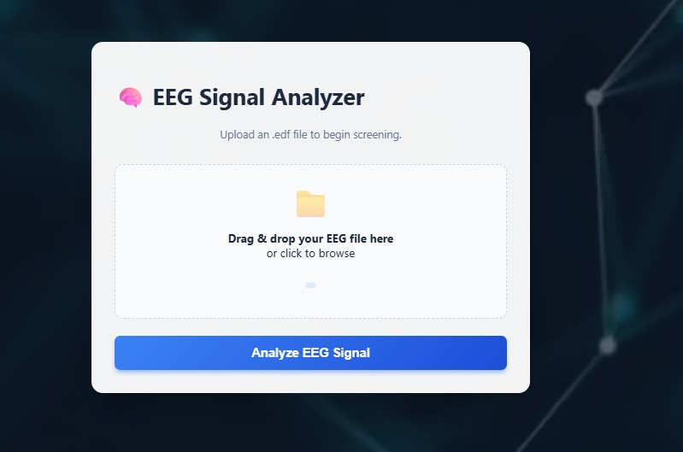
A Hybrid Neural Network for EEG-based Depression Screening Using CNN

Slide 33
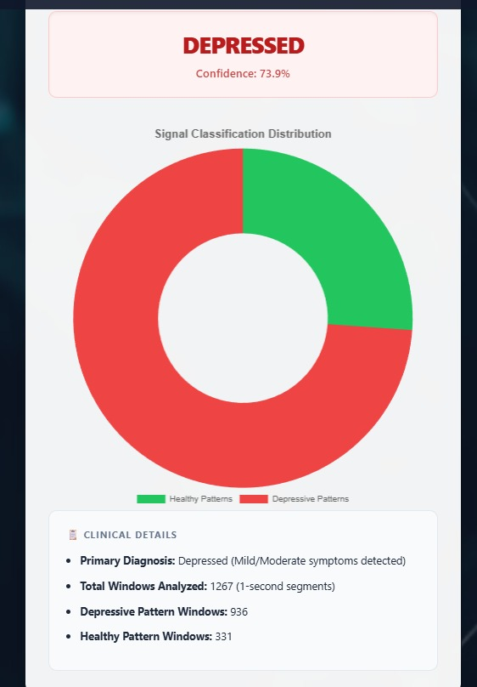
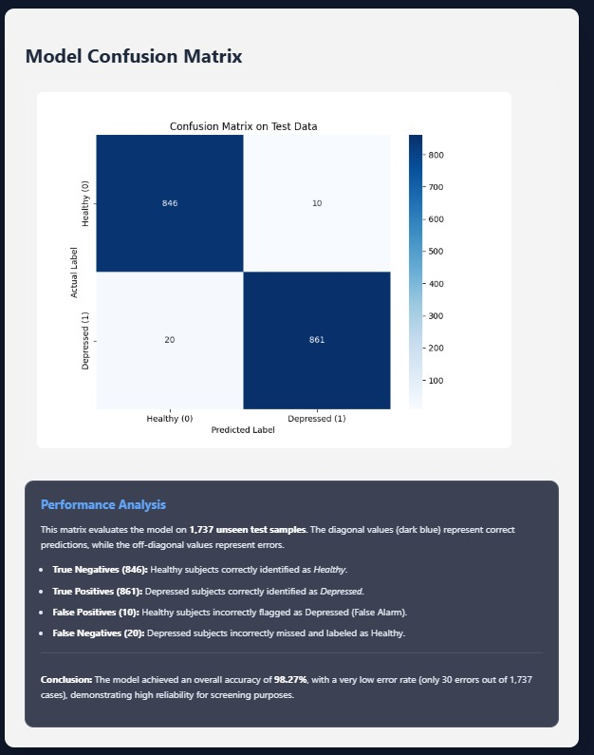
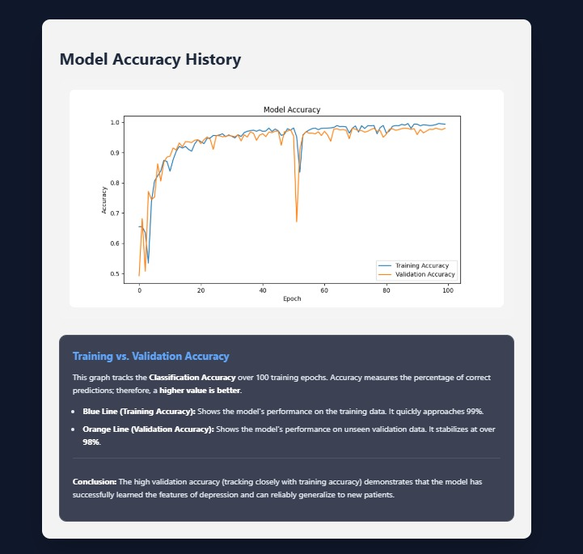

Slide 34
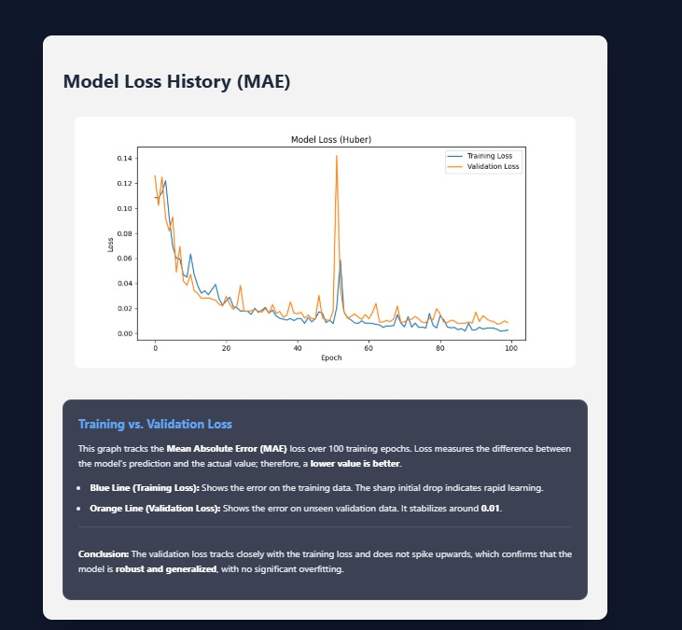
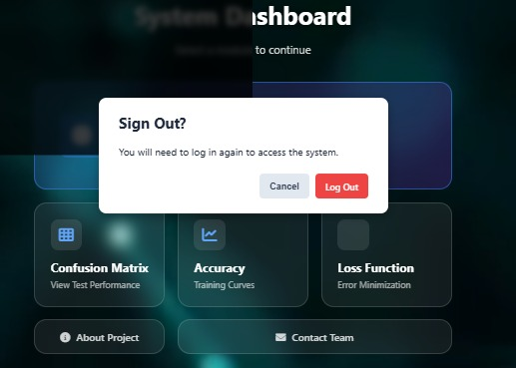

Slide 35
A Hybrid Neural Network for EEG-based Depression Screening Using CNN
CONCLUSION
DepHNN is a hybrid deep learning model combining CNN and LSTM for automated depression detection using EEG signals. It efficiently extracts temporal and sequential features without manual engineering and achieves high accuracy with minimal error and computation time. The model surpasses existing approaches in accuracy, efficiency, and robustness, making it a reliable computer-aided tool for early depression screening. Future improvements can enable severity analysis, use of larger datasets, and integration with IoMT systems for real-time mental health monitoring.

Slide 36
A Hybrid Neural Network for EEG-based Depression Screening Using CNN
FUTURE ENHANCEMENT
The system can be extended beyond binary classification to estimate depression severity levels, providing deeper clinical insights. Incorporating longitudinal EEG monitoring enables continuous tracking of treatment response and early relapse detection. By integrating multi-modal data such as EEG signals, heart rate variability, speech patterns, and facial micro-expressions, the system can offer a more comprehensive and reliable diagnosis of depressive disorders.

Slide 37
A Hybrid Neural Network for EEG-based Depression Screening Using CNN
REFERENCES
[1] Automated EEG-based screening of depression using deep convolutional neural network, U. R. Acharya, H. Fujita, S. L. Oh, Y. Hagiwara, J. H. Tan, and M. Adam
https://doi.org/10.1016/j.compbiomed.2018.06.008
[2] Deep convolutional neural network model for automated diagnosis of depression using EEG signals, S. L. Oh, U. R. Acharya, Y. Hagiwara, J. H. Tan, and H. Adeli
https://doi.org/10.3390/app9153319
[3] Implementation guides for CNN and LSTM using Keras’ Sequential API.
https://keras.io/guides/sequential_model/
[4] U.R. Acharya, S.L. Oh, Y. Hagiwara, J.H. Tan, H. Adeli, D.P. Subha, Automated EEG-based screening of depression using deep convolutional neural network, Comput. Methods Programs Biomed. 161 (2018) 103–113. https://www.sciencedirect.com/science/article/pii/S0169260718301494
[5] Electroencephalogram (EEG)-based computer-aided technique to diagnose major depressive disorder (MDD)” by W. Mumtaz, L. Xia, S. S. A. Ali, M. A. M. Yasin, M. Hussain, A. S. Malik (2017), https://www.sciencedirect.com/science/article/abs/pii/S1746809416300866
[6] Deep convolutional neural networks for computer-aided detection: CNN architectures, dataset characteristics and transfer learning” by H.-C. Shin, H. R. Roth, M. Gao, L. Lu, Z. Xu, I. Nogues, J. Yao, D. Mollura, R. M. Summers (2016), https://pubmed.ncbi.nlm.nih.gov/26886976/

Slide 38

A Hybrid Neural Network for EEG-based Depression Screening Using CNN
Dept of AI&DS, SJCIT
2025-26
38

